Slide 1
Introduction to Computing for Data Analysis
Linear regression
Richard Vuduc, Ph.D.
Associate Professor
School of Computational Science and Engineering
Computational costs
Notes:
You now have an algorithm to fit a linear model to your data.
The next computer science question to ask is, what does it cost to run the algorithm?
You’ll consider that question in this lesson, as well as through a notebook that accompanies it.

Slide 2
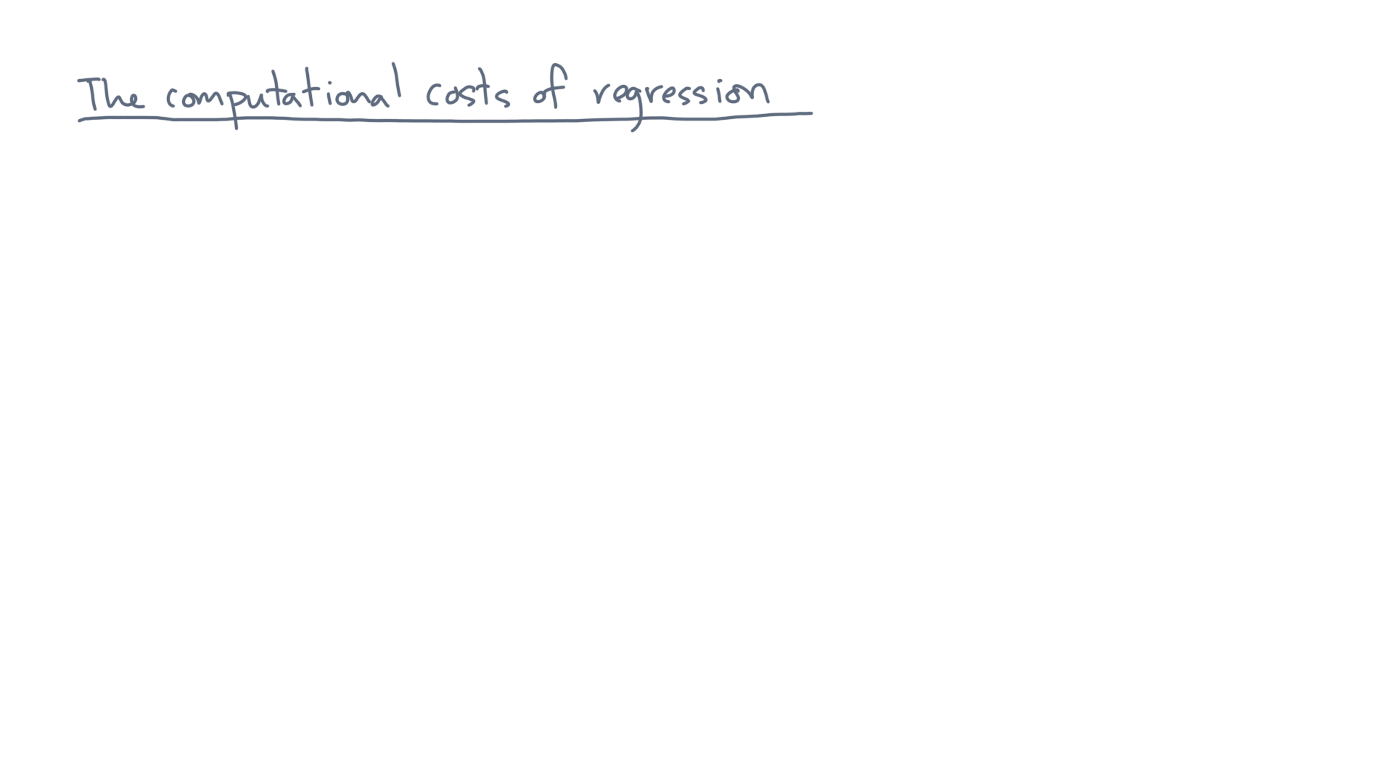
Notes:
Let’s recall the linear regression problem.

Slide 3
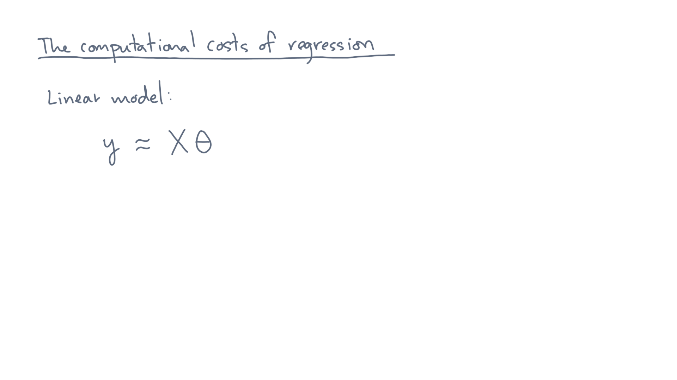
Notes:
You are given a vector, y, of m responses.

Slide 4
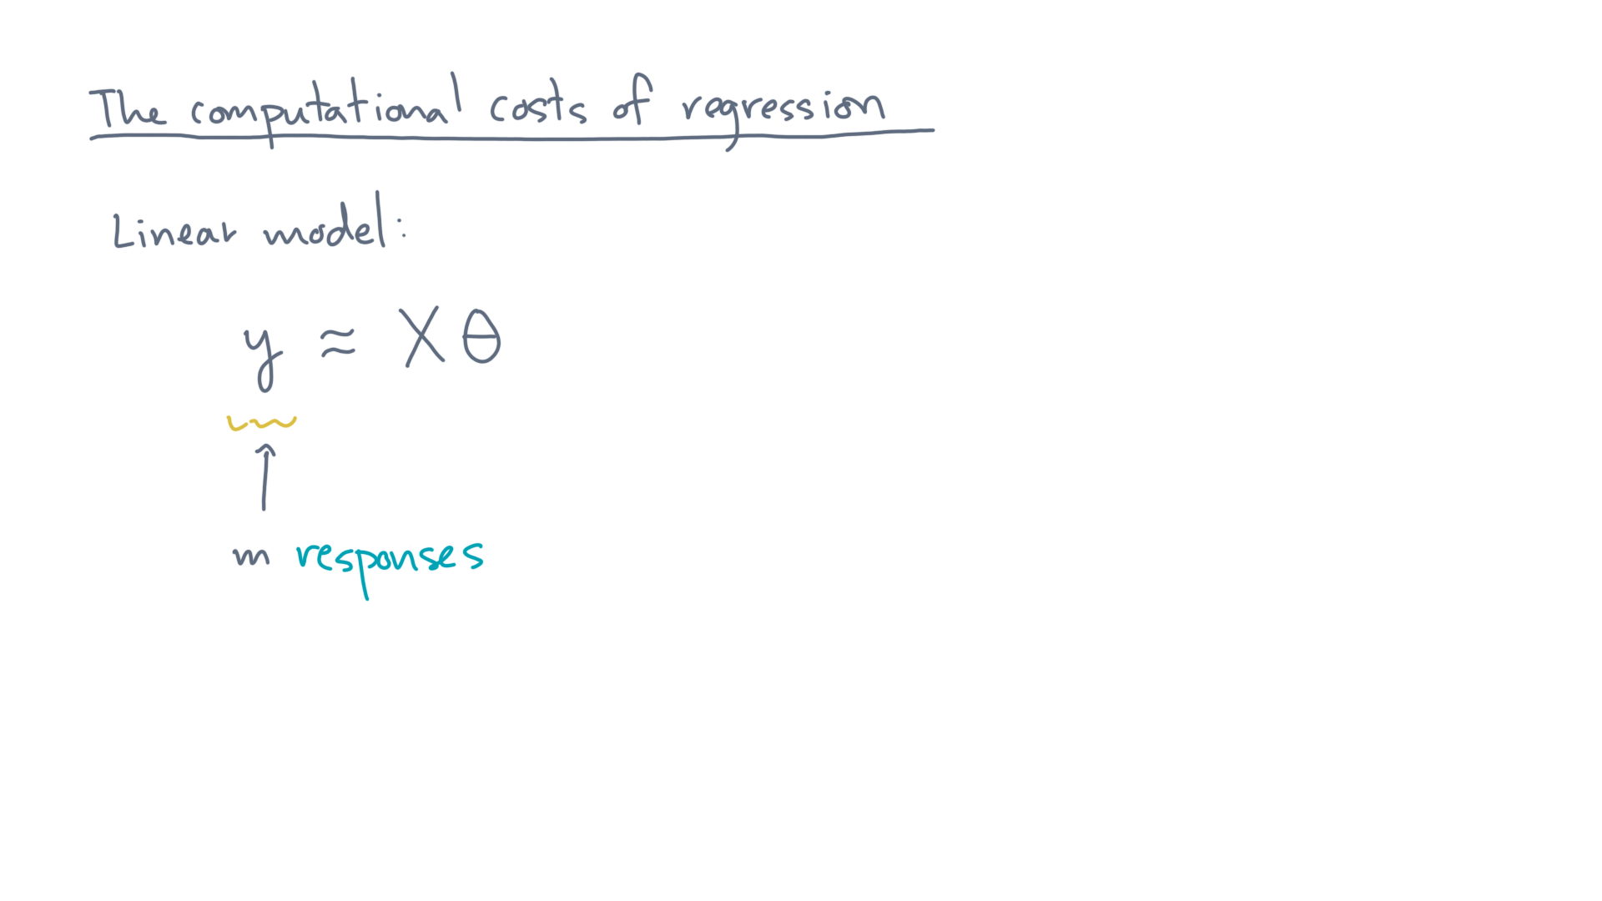
Notes:
You also have an accompanying data matrix, X.

Slide 5
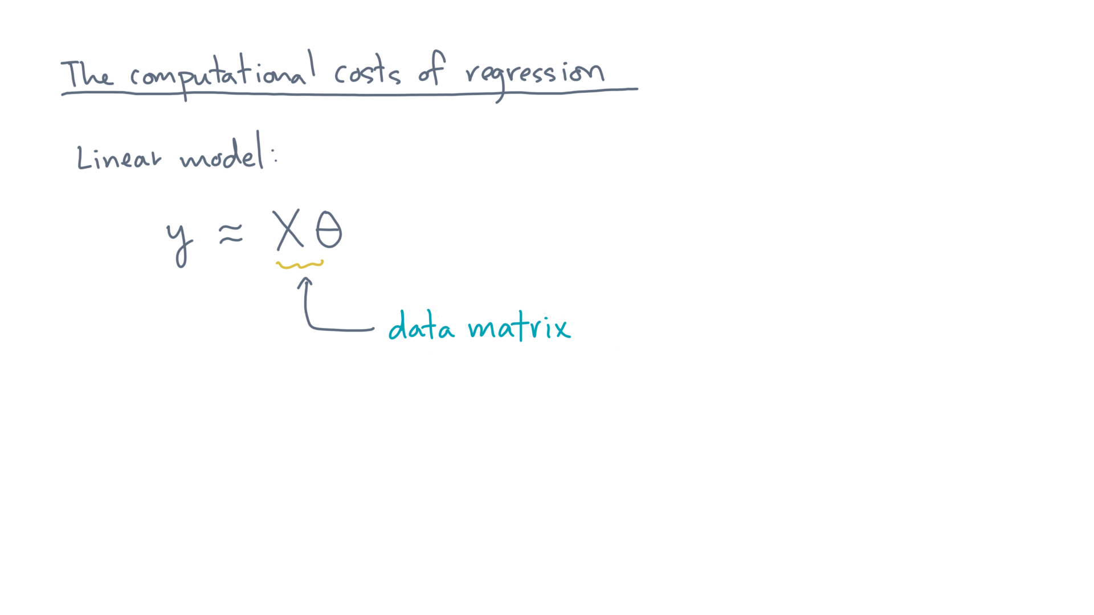
Notes:
X contains m observations, which are its rows.

Slide 6
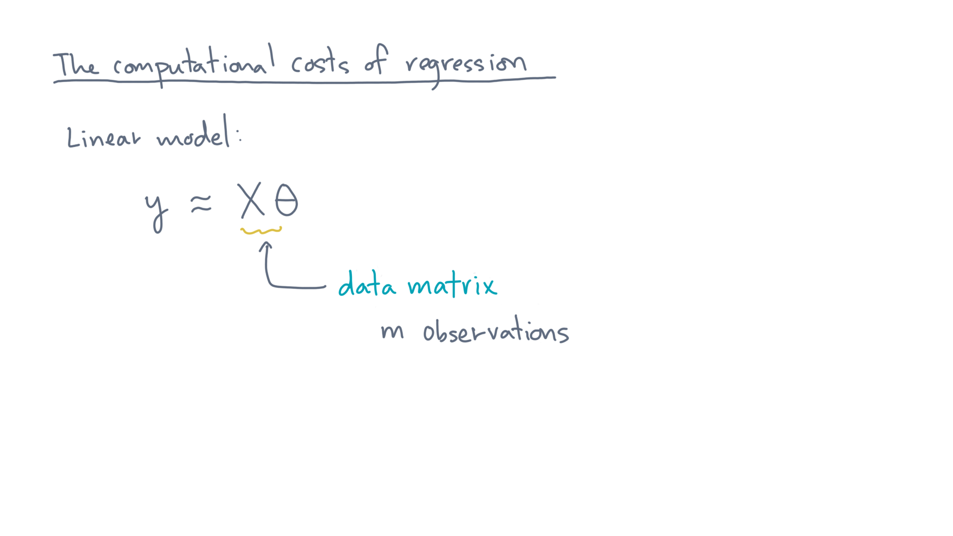
Notes:
And each column corresponds to a predictor variable.

Slide 7
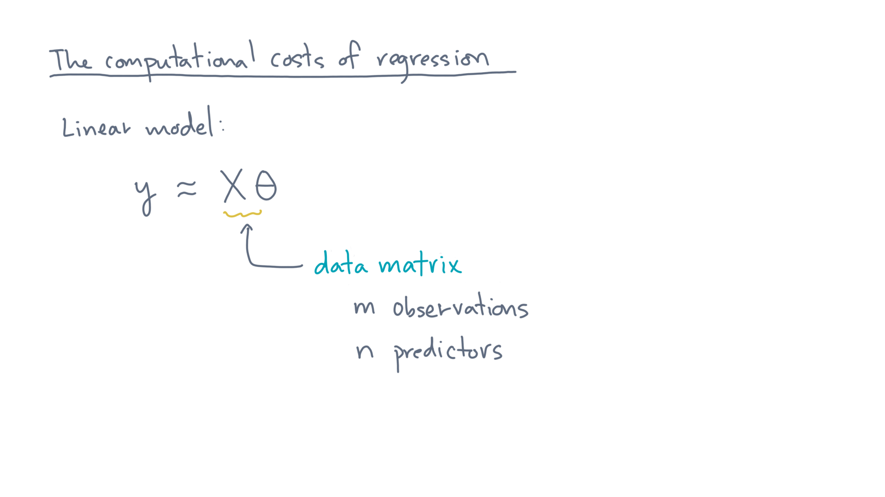
Notes:
Let’s assume there are n of them.

Slide 8
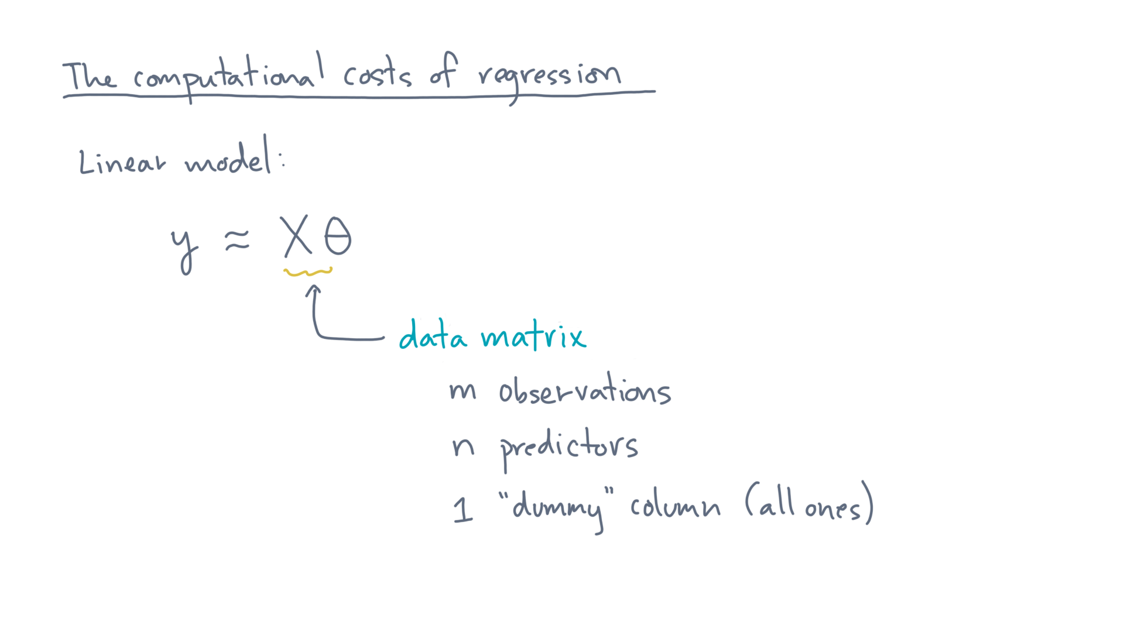
Notes:
And to allow for an “intercept” parameter, let’s assume an additional dummy column consisting of all ones.

Slide 9
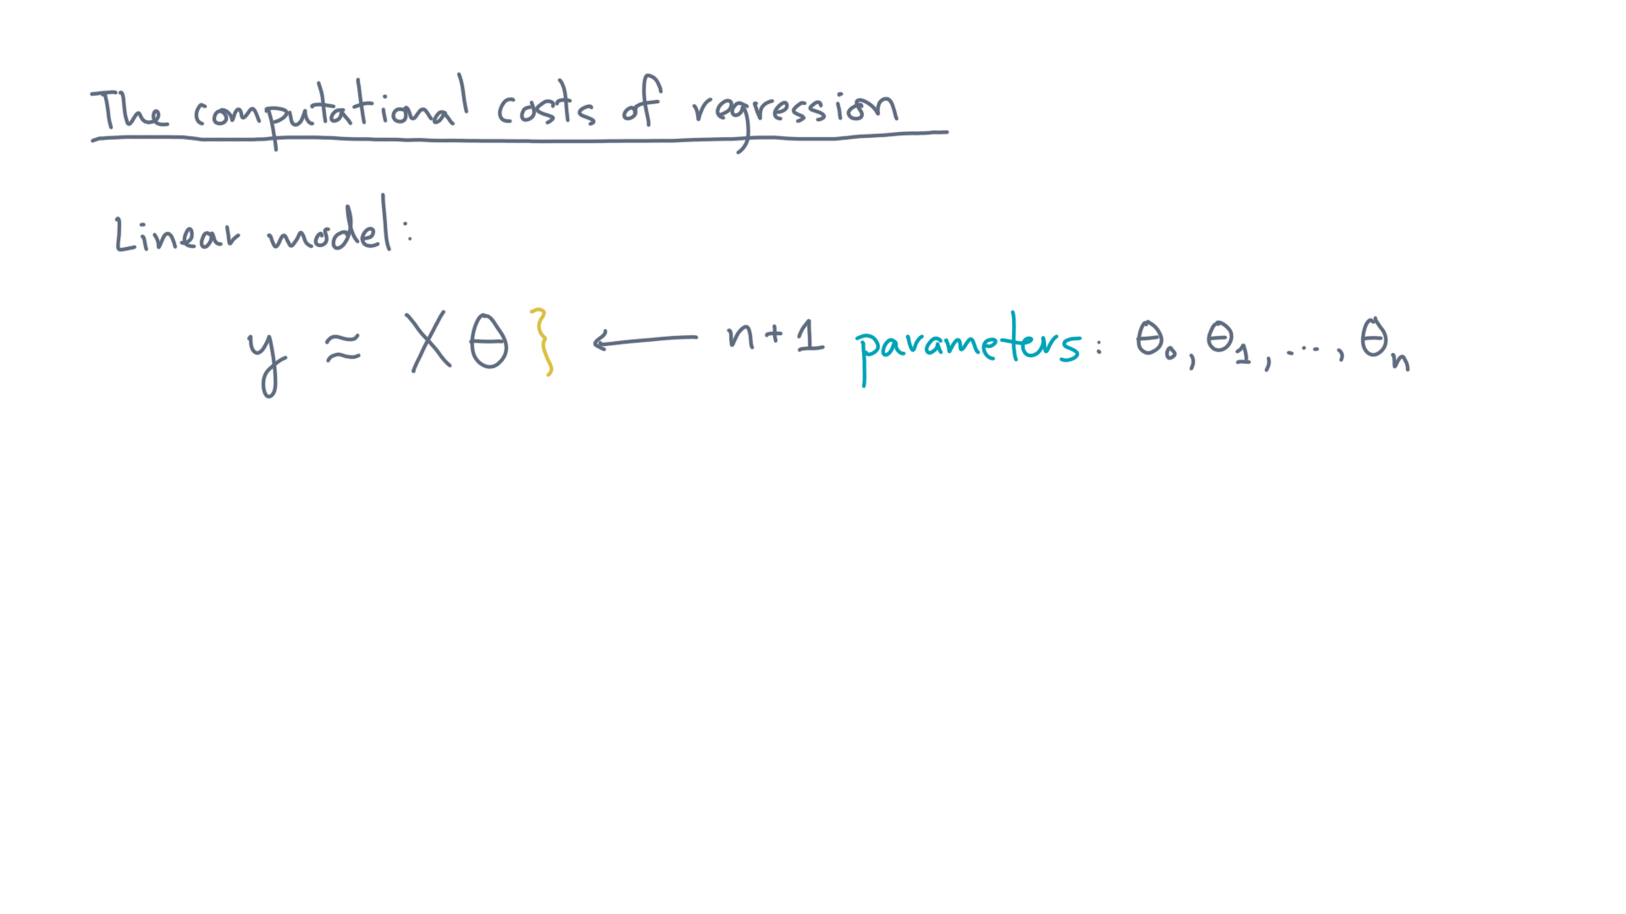
Notes:
Lastly, there is Theta, which is a vector of n+1 model parameters, theta-zero through theta-n.

Slide 10
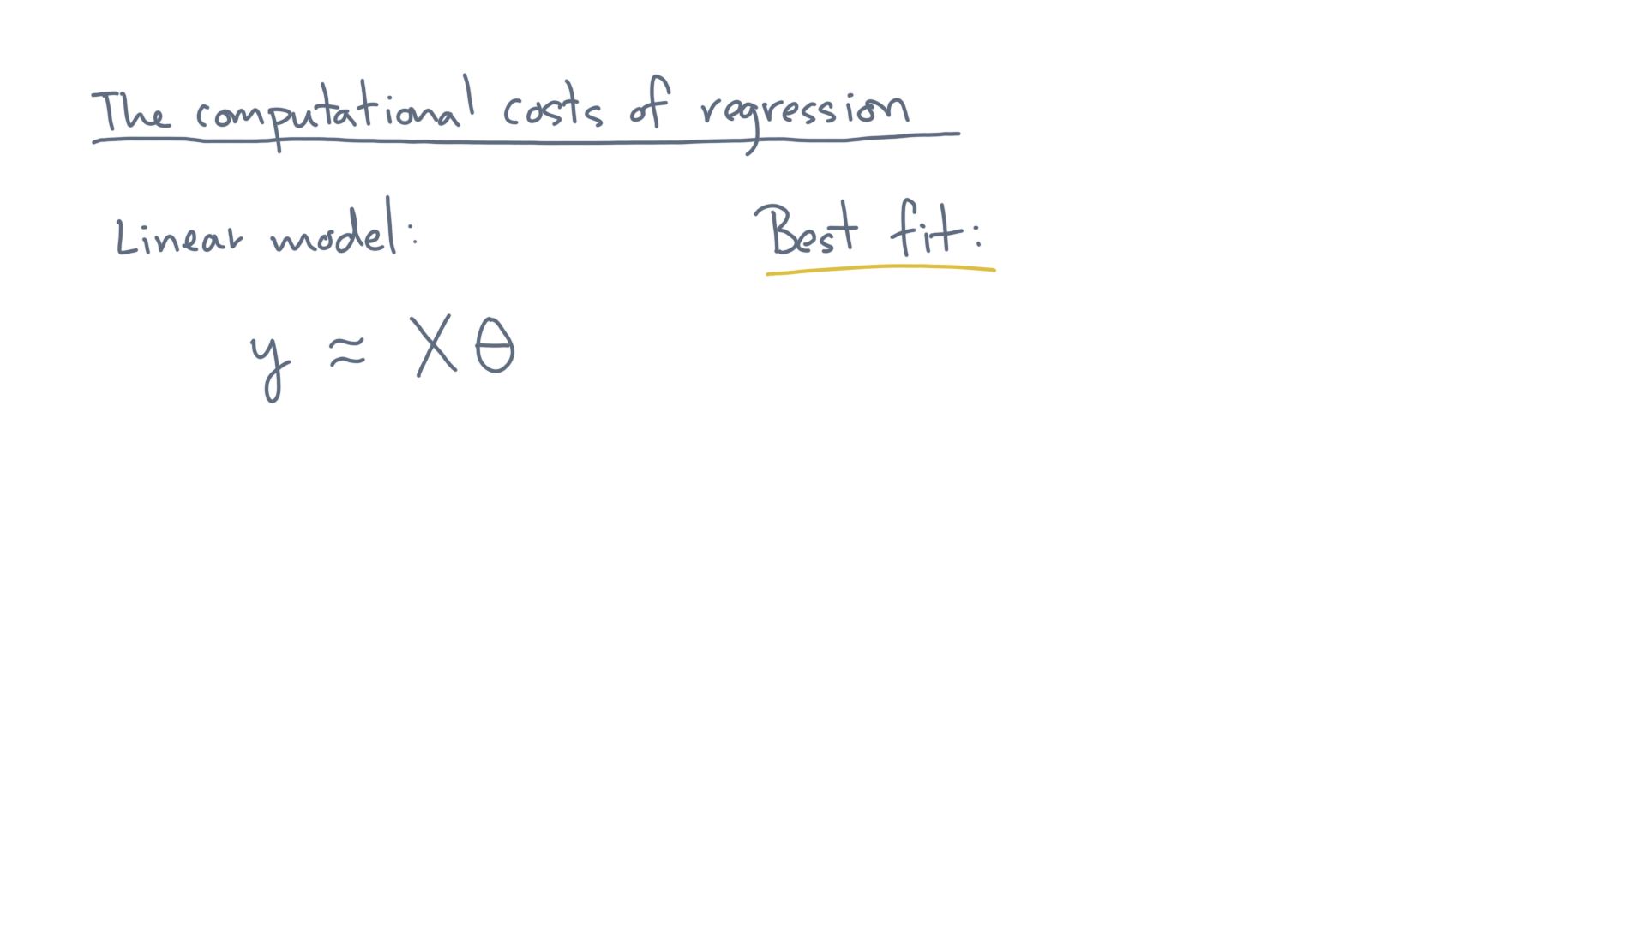
Notes:
“Fitting” this model to the data means computing the “best” value of Theta.
But what is best?

Slide 11
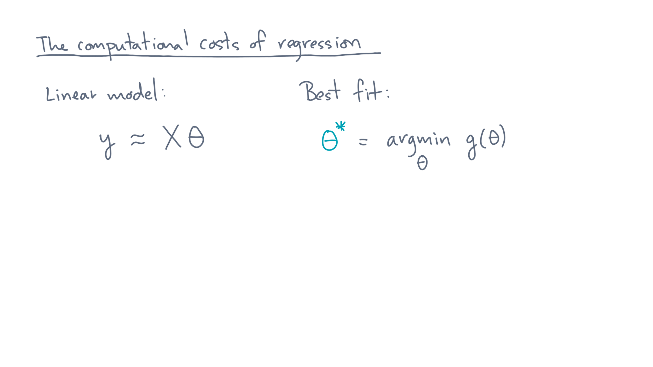
Notes:
We defined that through a minimization problem:

Slide 12
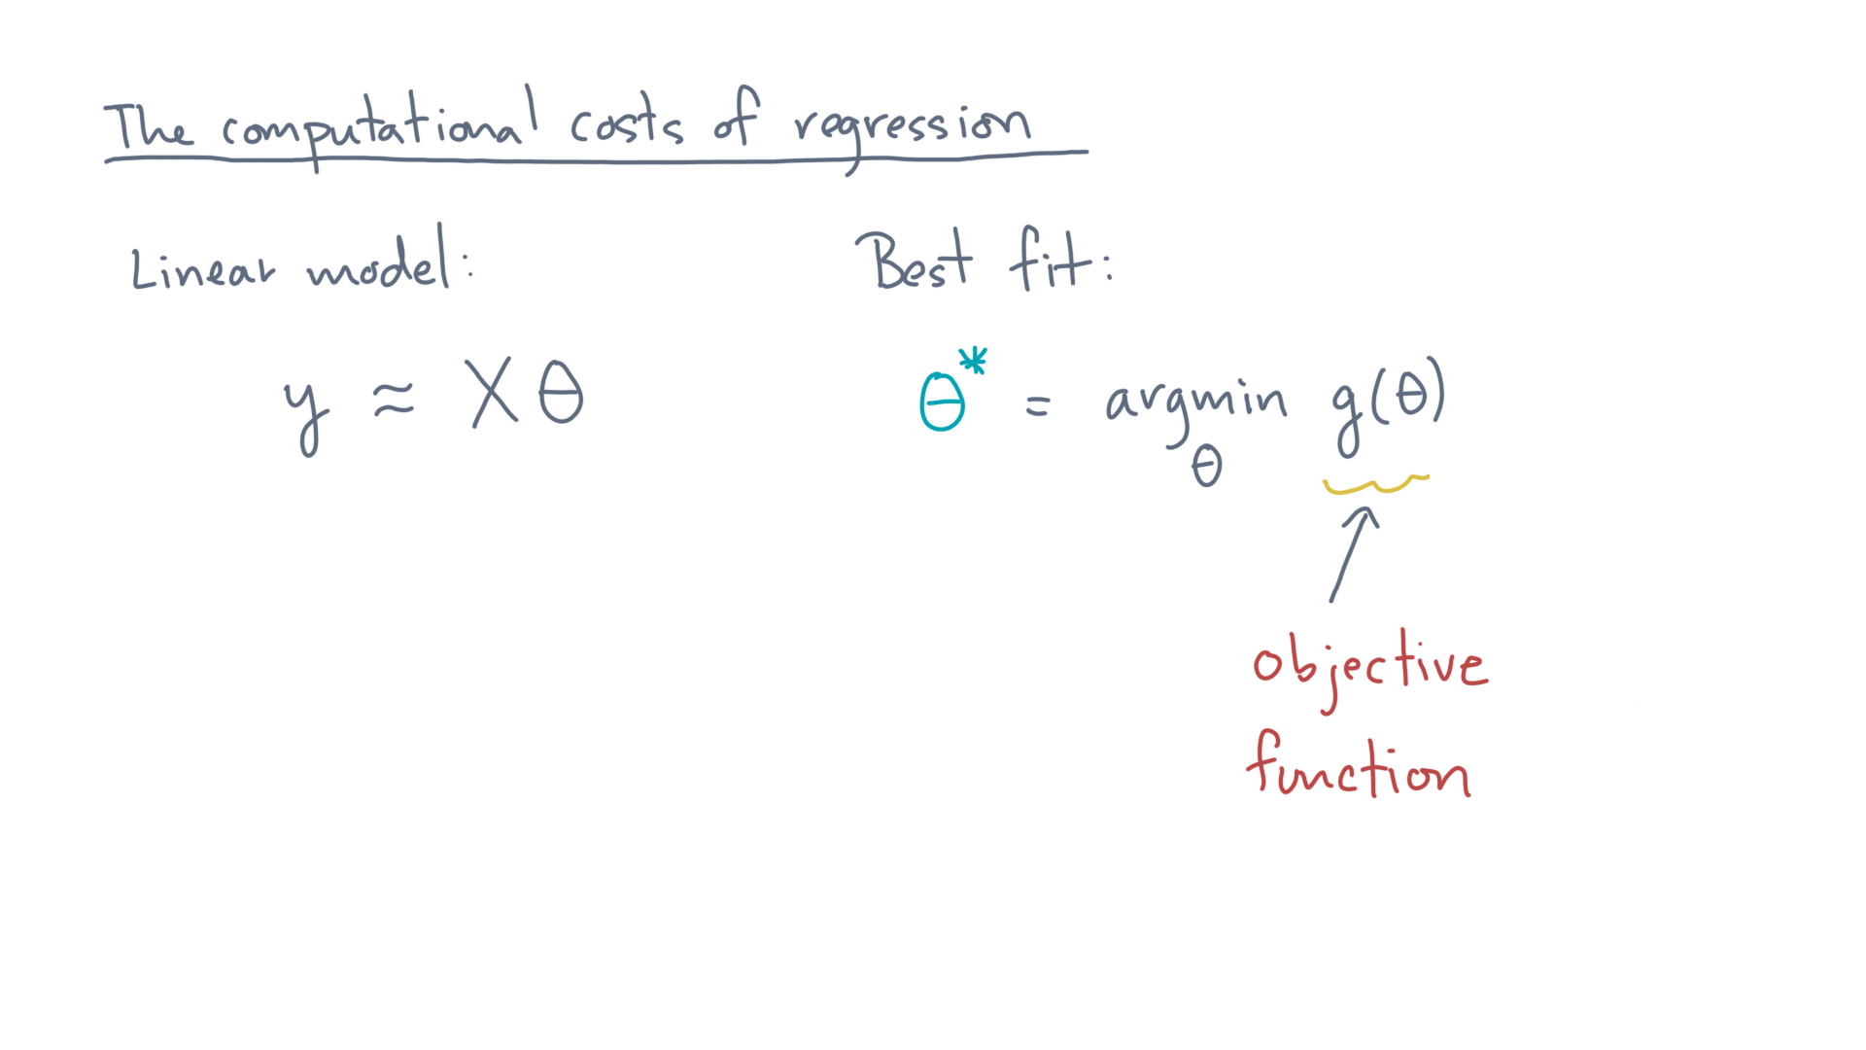
Notes:
Given some cost function, or objective function, g-of-theta, find the optimum, theta-star, that minimizes this cost.

Slide 13
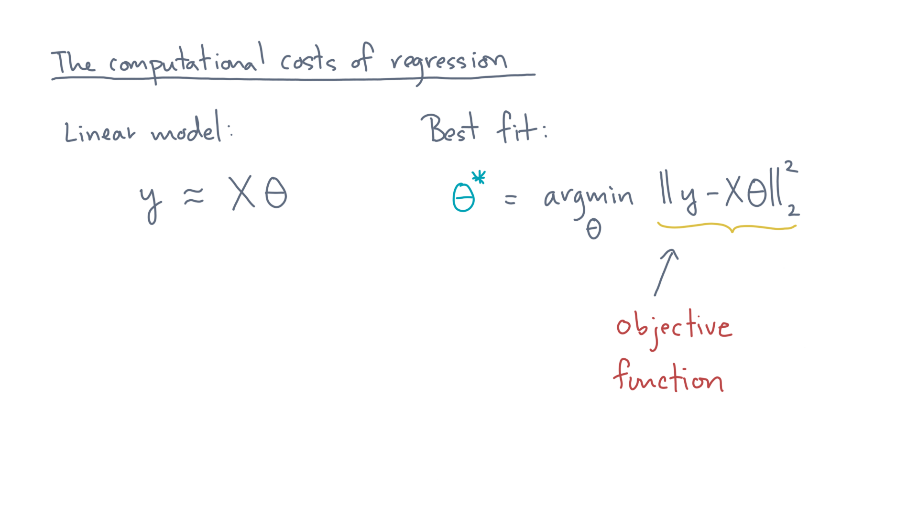
Notes:
There are many choices for g, but we used this one:

Slide 14
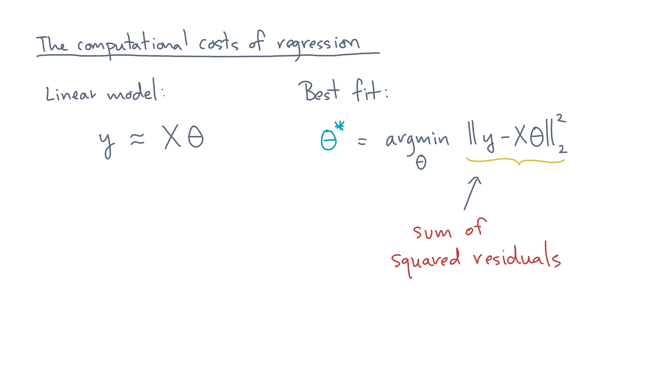
Notes:
It’s the sum of squared errors, or residuals.

Slide 15
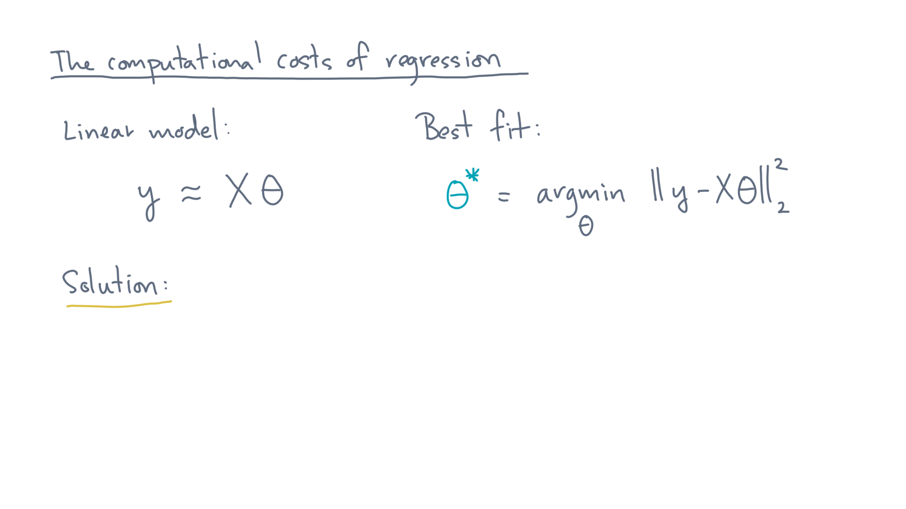
Notes:
So what’s the solution to this minimization problem?

Slide 16
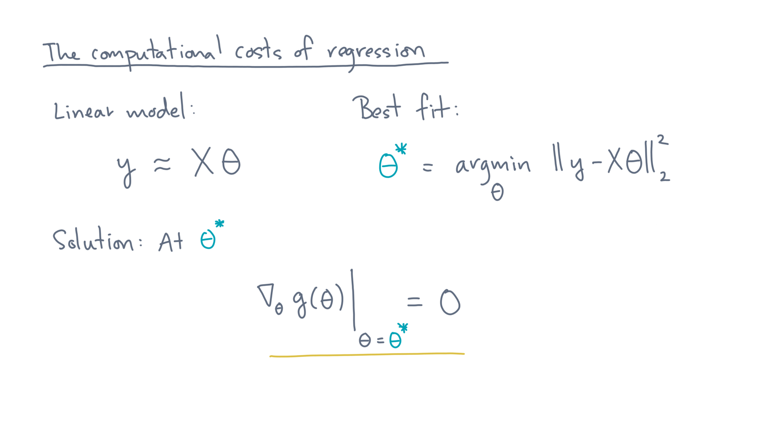
Notes:
At the minimizer, or any extreme point, really, we know the gradient must be zero.
And in the case of the sum of squared residuals for a linear model, we can compute the gradient exactly:

Slide 17
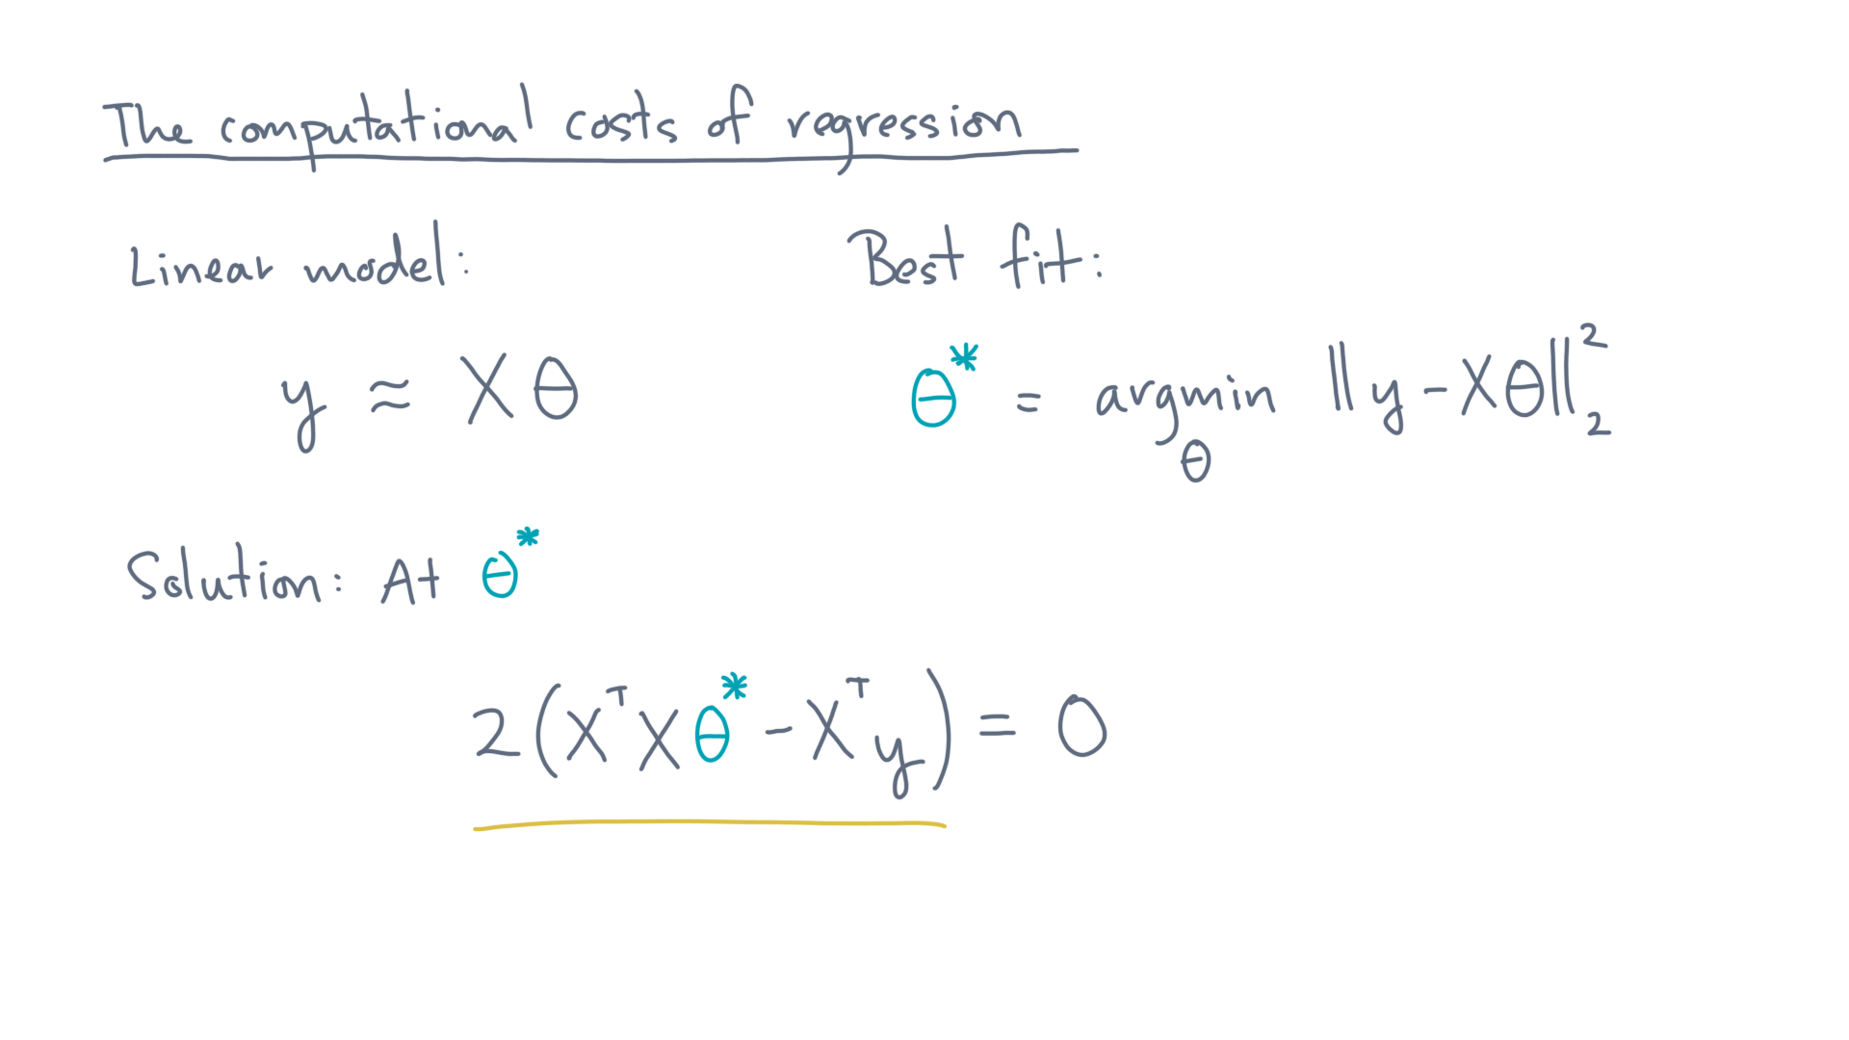
Notes:
It’s 2 times the quantity X-transpose-X-theta-star – X-transpose-y.
In other words…

Slide 18
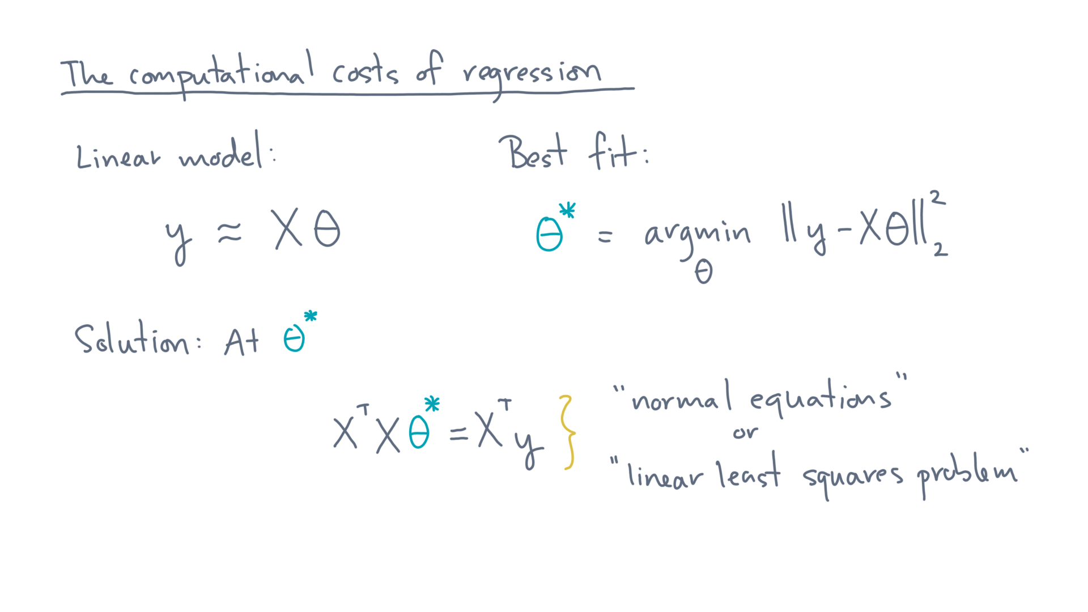
Notes:
X-transpose-X-theta-star equals X-transpose-y.

Slide 19
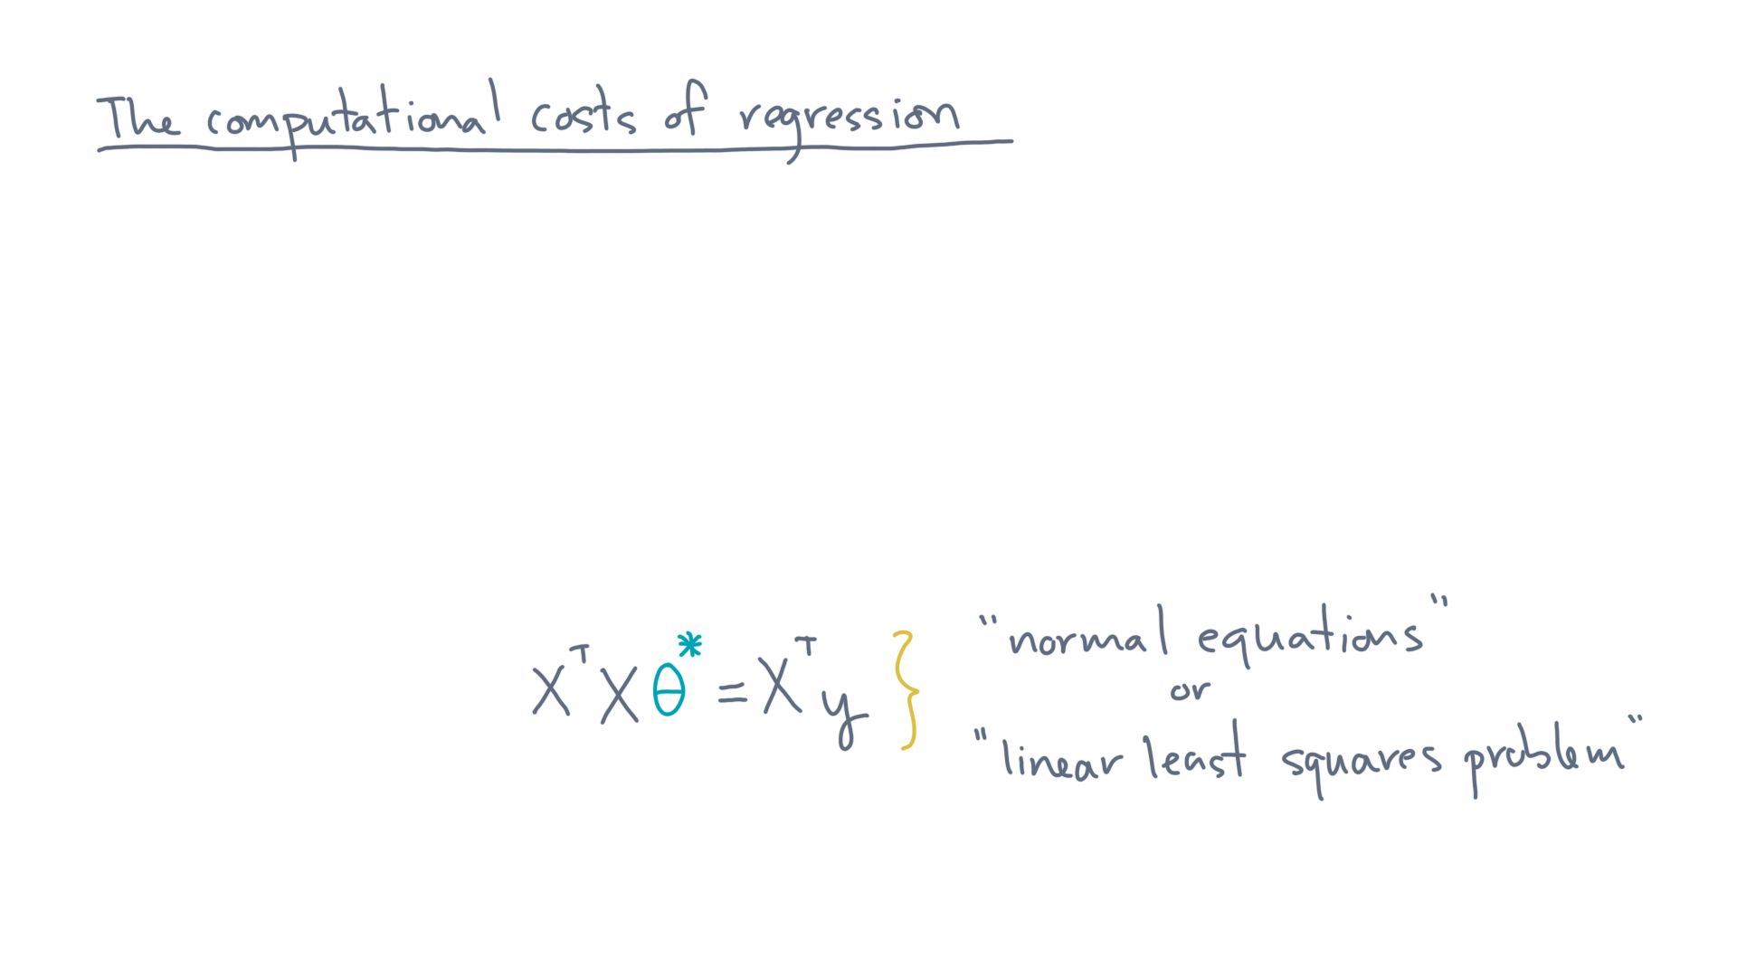
Notes:
This system of equations is also known as the “normal equations” or as the “linear least-squares problem.”

Slide 20
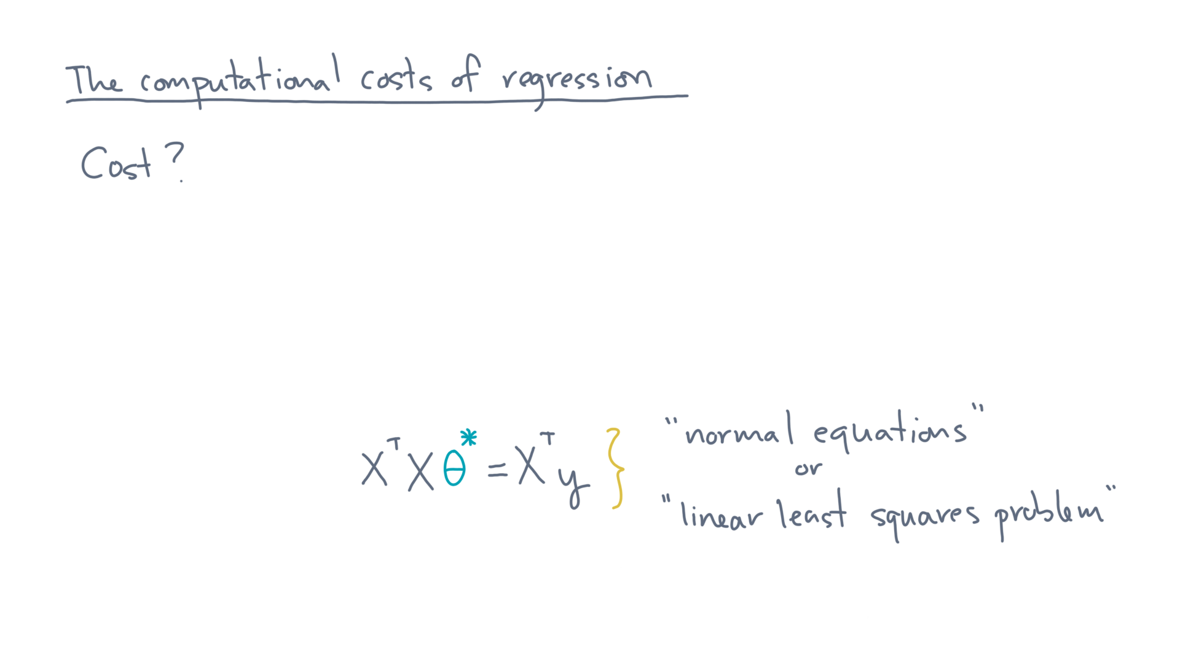
Notes:
So what does it cost, computationally speaking?

Slide 21
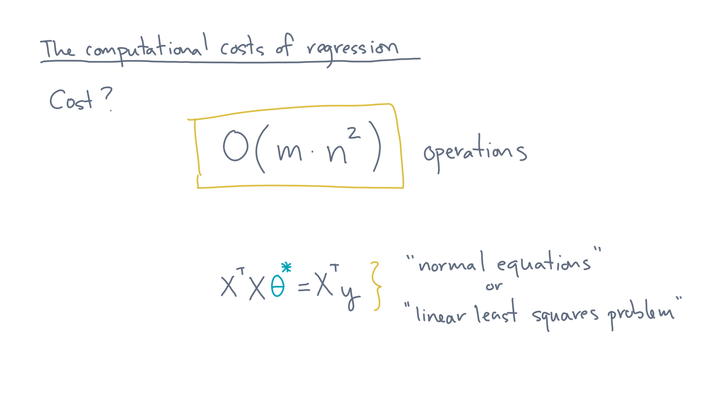
Notes:
It turns out to be on the order of the number of observations, m, times the square of the number of predictors.

Slide 22
Notes:
You now know on what it costs, asymptotically, to fit a linear model. So what’s next?
Well, you should now look at the companion notebook we created for this lesson. It reviews what you just watched but also asks you to write some code and run some experiments. We hope that gives you a more complete picture about how linear regression works computationally in practice.

